Slide 1
Higher level semantic interpretation framework
Rutu Mulkar-Mehta and Jerry Hobbs
Information Sciences Institute
University of Southern California
Marina del Rey, CA, USA

Slide 2
Outline
Abduction: The Big Picture
General problem Solving using Abduction
Biology
Causality
Video-Text Coreference: A Small Experiment

Slide 3
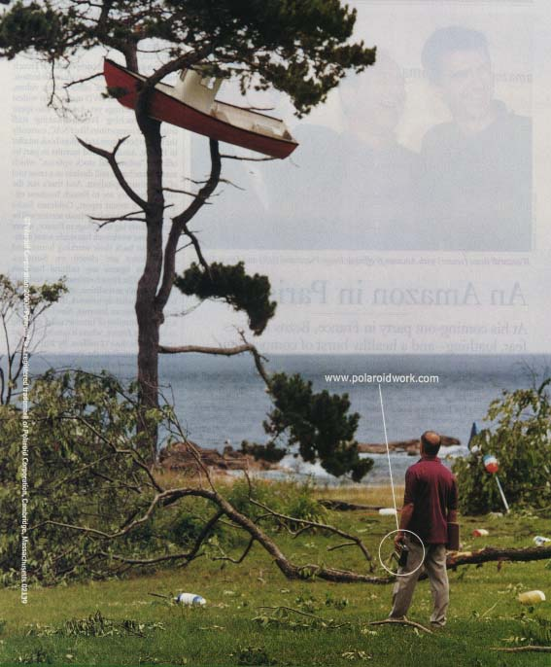

Slide 4
Interpreting the Environment: Picking the Best Explanation
boat in tree
branch down
crane
chopped down
storm
?

Slide 5
Interpreting the Environment: Picking the Best Explanation
boat in tree
branch down
in magazine
crane
chopped down
storm
ad agency
advertisement

Slide 6
Interpretation as Abduction
To Interpret a Situation: Find the best explanation
for the observables.
Abduction: Inference to the best explanation.
Represent the observables as propositions.
2. Prove them, using the axioms in the knowledge base.
3. Allow assumptions in the proof, at a cost.
4. Pick the most economical proof.

Slide 7
Interpretation as Abduction
To interpret an utterance, find the best explanation
for the propositional content of the utterance.
1. Represent the content as predications (the
logical form).
2. Prove them, using the axioms in the knowledge
base.
3. Allow assumptions in the proof, at a cost.
4. Pick the lowest cost proof.
I went to the beach and caught a big wave.
I went to the beach and caught a big tuna.
Speaker
MB
Hearer
Utt

Slide 8
Factors in Most Economical Proof
Shortest proof
Fewest and most plausible assumptions
Most salient axioms
Greatest redundancy
Language has a huge amount
of implicit redundancy.
Recognizing redundancies
yields more propositions proved
for fewer assumptions

Slide 9
Lexical Ambiguity
The plane taxied to the terminal.
LF:
plane(x) & taxi(x,y) & terminal(y)
KB:
airplane(x) --> plane(x)
wood-smoother(x) --> plane(x)
computer-terminal(y) --> terminal(y)
airport-terminal(y) --> terminal(y)
move-on-ground(x,y) & airplane(x) --> taxi(x,y)
ride-in-cab(x,y) & person(x) --> taxi(x,y)
airport(z) --> airplane(x) & airport-terminal(y)

Slide 10
Lexical Ambiguity
The plane taxied to the terminal.
LF:
plane(x) & taxi(x,y) & terminal(y)
KB:
airplane(x) --> plane(x)
move-on-ground(x,y) & airplane(x) --> taxi(x,y)
airport(z) --> airplane(x) & airport-terminal(y)
airport-terminal(y) --> terminal(y)
wood-smoother(x) --> plane(x)
ride-in-cab(x,y) & person(x) --> taxi(x,y)
computer-terminal(y) --> terminal(y)

Slide 11
Abduction Pipeline
Biology, Causality

Slide 12
Functional Overview and Components
Natural Language Component
Syntactic Parsing of text
Backend Reasoning Engine
Conversion of parse to Shallow Logical form
Abductive Inferencing

Slide 13
Natural Language Pipeline
Sentence: “the heart is a pump”
Parse Tree:
(SUBJ) [2] The heart [S-NP]
(DET) [3] The [S-DEF-ART]
(PRED) [4] heart [S-COUNT-NOUN]
(PRED) [5] is [S-AUX]
(OBJ) [6] a pump [S-NP]
(DET) [7] a [S-INDEF-ART]
(PRED) [8] pump [S-NOUN]
Logical Form: heart-nn’(e2,x0) & be’(e0,x0,x1) & pump-nn’(e1,x1)

Slide 14
Biology Domain
Reviving semantic linkages

Slide 15
Example
Sentence: The heart is a pump that supplies blood to various parts of the body Logical Form: heart-nn’(x0) & be’(x0,x1) & pump-nn’(x2) & supply-vb’(x4,x3) & blood-nn’(x7) & to’(x6,x9) & various-adj’(x9) & part-nn’(x9) & of’(x8,x10) & body-nn’(x10)
Triples before Abduction
(( x0-heart instance-of heart )
( x0-heart is x1 )
( x2-pump instance-of pump )
( x4 supply x3 )
( x7-blood instance-of blood )
( x9-part destination-of x6 )
( x9-part MOD various )
( x9-part instance-of part )
( x10-body instance-of body )
( x8 of x10-body ))
Triples after Abduction
((x4-heart instance-of heart)
( x4-heart of-type device )
( x3-blood of-type fluid )
( x4-heart is x1 )
( x2-pump instance-of pump )
( x4-heart agent-of e4-supply )
( x3-blood object-of e4-supply )
( x3-blood instance-of blood )
( x9-part destination-of x6 )
( x9-part MOD various )
( x9-part instance-of part )
( x8 of x10-body )
( x10-body instance-of body ))

Slide 16
Writing Axioms
Currently Axioms are handcrafted
Method of introducing constraints on arguments and supertype relations into a system that performs only backchaining
Example Axioms for Nouns
device’(e2,x1) & heart-nn’(e1,x1) → heart-nn’(e1,x1)
fluid’(e2,x1) & blood-nn’(e1,x1) → blood-nn’(e1,x1)
Analogous to et cetera propositions (Hobbs et al. 1993)
device’(e2,x1) & etc’(e1,x1) → heart-nn’(e1,x1)
Example Axioms for Verbs
device’(e2,x1) & fluid’(e2,x0) & supply-vb’(e3,x1,x0) → supply-vb’(e3,x1,x0)

Slide 17
Using Abduction for Semantic Linkage
Backchaining into some KR theories
Coreference by Factoring
Unification of variables when the predications are the same
LF from “…heart(x1)….supply(x2,y2)…. blood(y3)…”
broken parse
device(x1)&heart(x1)
fluid(y3)&blood(y3)
x1=x2
y2=y3
device(x2) & fluid(y2) & supply(x2,y2)
Connected logical form: heart(x2) & device(x2) & supply(x2,y2) & blood(y2) & fluid(y2)

Slide 18
Problem
Abduction helps for factoring
Still, remaining problem: Too many unrecognized verbs and phrases
Solution: harvest expressions from the web, add knowledge into parser and LF Toolkit resources

Slide 19
Collection of Resources
Scanning of 10GB of web-scraped data
Selected sentences with key concepts and keywords (e.g., “heart”, “blood”…)
Restricted selection based on the proximity of 2 keywords to one another
Reject sentences with keyword distance greater than 7
Further manual elimination: Remove irrelevant sentences (e.g. “…heart disease and high blood pressure…”)
Total 118 unique sentences / concepts shortlisted
35 new verbs added

Slide 20
Disambiguation of Interpretations
Simple words may have multiple senses
E.g. “supply”
Heart supplies Blood (Device supplies Fluid)
Blood supplies Oxygen (Fluid supplies Chemical)
Heart supplies Oxygen (Device supplies Chemical)
Candidate Axioms:
device’(e2,x1) & chemical’(e3,x0) & supply-vb’(e1,x1,x0) → supply-vb’(e1,x1,x0)
device’(e2,x1) & fluid’(e3,x0) &supply-vb’(e1,x1,x0) → supply-vb’(e1,x1,x0)
fluid’(e2,x1) & chemical’(e3,x0) & supply-vb’(e1,x1,x0) → supply-vb’(e1,x1,x0)
Logical Form for sentence “The heart is a pump that supplies blood to various parts of the body.”
heart-nn’(e0,x0) & be’(e1,x0,x1) & pump-nn’(e2,x2) & supply-vb’(e3,x4,x3) & blood-nn’(e4,x7) & to’(e5,x6,x9) & various-adj’(e6,x9) & part-nn’(e7,x9) & of’(e8,x8,x10) & body-nn’(e9,x10)

Slide 21
Disambiguation of Interpretations (Contd.)
LF from “…heart(x1)….supply(x2,y2)…. blood(y3)…”
broken parse
Cost : 6
device(x1) & heart(x1)
fluid(y3) & blood(y3)
x2=y3
fluid(x2) & chemical(y2) & supply(x2,y2)
Connected logical form: heart(x1) & device(x1) & supply(x2,y2) & chemical(y2) & blood(x2) & fluid(x2)
LF from “…heart(x1)….supply(x2,y2)…. blood(y3)…”
broken parse
Cost : 6
device(x1) & heart(x1)
fluid(y3) & blood(y3)
x1=x2
device(x2) & chemical(y2) & supply(x2,y2)
Connected logical form: heart(x2) & device(x2) & supply(x2,y2) & chemical(y2) & blood(y3) & fluid(y3)

Slide 22
Disambiguation of Interpretations (Contd.)
LF from “…heart(x1)….supply(x2,y2)…. blood(y3)…”
broken parse
Cost : 5
device(x1)&heart(x1)
fluid(y3)&blood(y3)
x1=x2
y2=y3
device(x2) & supply(x2,y2) & fluid(y2)
Connected logical form: heart(x2) & device(x2) & supply(x2,y2)
& blood(y2) & fluid(y2)
As this is the lowest cost interpretation possible, this is the interpretation selected by the system.
Note: Incorrect unification in nouns is blocked when 2 entities are described by distinct nouns

Slide 23
Temporal and Causal Relations in Biomedical Texts

Slide 24
Causal and Temporal Information in Biomedical Texts
Biomedical texts are rich in causal and temporal information conveyed via various overt temporal markers
XPD appears to be degraded in wild-type embryos
between
prophase and metaphase of the first cell division
after
the onset of zygotic gene expression,
which coincides with
a redistribution of CDK7 from the cytoplasm to the nucleus.
A
between
B and C
after
D
which coincides with
E.
B A C
D = E

Slide 25
Annotation Effort
What we want to annotate:
Events in the text and the causal and temporal relation between those events per sentence.
Step 1: Event Identification:
TARSQI captured non-biology specific verbs and event nouns
Biology specific events were manually annotated (e.g. transcription, regulation)
Step 2: Identify relation between events
Annotation Tool:
RSTTool (Version 3.0) by Michael O’Donnell
http://www.wagsoft.com/RSTTool/
Tool allowed: text segmentation, text structuring, relation specification, and maintenance of statistics for relations.
How to Annotate:
Fragment sentence into individual fragments that convey a temporal relation
Create a temporal link connecting the head of one fragment to the head of the other
Corpus
190 sentences from Biomedical literature
Relations: before, simultaneous

Slide 26
Signals that indicate temporal precedence
Words conveying causality:
E.g. In Drosophila, inactivation of the CDK7 mutant causes embryonic and larval lethality and a block to mitosis in the germline.
Mutations in the gene encoding XPD lead to dysregulation of nuclear-receptor-dependent gene expression.
Words conveying aspect:
E.g. In S. pombe, the Wee1 kinase allows entry into mitosis when cells reach a minimum threshold size.
Words conveying dependence:
E.g. Regulation of cell cycle progression is another general stress response critical for cell survival.
Words conveying control:
E.g. Dephosphorylation of these residues by the Cdc25 phosphatase is the key event governing the initiation of mitosis.

Slide 27
Baseline Calculation
Baseline 1: (Random)
System was given all the events involved in a temporal relation
System randomly picked 2 events within a sentence and gave it a random relation (Relations: Before, during)
Baseline 2: (Simple but bad heuristic: Text order reflects event order)
System was given all the events involved in a temporal relation
System gave a relation to all events in a sentence based on the order of occurrence. (X …. Y → X before Y)

Slide 28
Exposure of cells to stress results in rapid activation of MAPKs.
exposure-nn(x2) & of-in(x2,x10) & cell-nn(x10) & to-in(x2,x6) & stress-nn(x6) & result-vb’(e0,x2) & in-in(e0,x8) & rapid-adj(x8) & activation-nn(x8) & of-in(x8,x12) &mapks-nn(x12)
exposure-nn(x2) & …& result-vb’(e0,x2) & in-in(e0,x8) & …& activation-nn(x8) & …
BEFORE(x2,x8) & CAUSES(x2,x8)
Final Logical Form: exposure-nn(x2) & …& BEFORE(x2,x8) & CAUSES(x2,x8) & …& activation-nn(x8) & …

Slide 29
Axiom Creation Process: Manual
66 Axioms (Causal and aspectual words)
190 sentences from 2 biomedical articles on the cell cycle
1 2 3 4 5 | Causal Axioms CAUSES(x3,e4) & BEFORE(x3,e4) → in-in(e4,x2) & response-nn(x2) & to-in(x2,x3) CAUSES(x0,x8) & BEFORE(x0,x8) → result-vb’(e0,x0) & in-in(e0,x8) CAUSES(x1,x3) & BEFORE(x1,x3) → lead-vb’(e1,x1) & to-in(e1,x3) CAUSES(e4,x3) & BEFORE(e4,x3) → in-in(e4,x2) & order(x2) & to-in(x2,x3) CAUSES(x15,e14) & BEFORE(x15,e14) → upon(e14,x15)
6 7 8 | Aspectual Axioms BEGINS(x1,e2) →start-vb’(e1,x1,e2) BEGINS(x1,x2) →progression-nn(x1) & into-in(x1,x2) BEGINS(x1,x2) →onset-nn(x1) & of-in(x1,x2)

Slide 30
Semi-Automatic Axiom Creation
Results for Causal Relations
308 phrases were returned
182 were syntactic variations of the original seed
Remaining 126 patterns could be collapsed into 100 pattern classes
Only 9 pattern classes of the 100 were good , low freq
91 patterns were bad (e.g. Y 's ambassador said X, X -- held northern Y)
Results for Aspectual Relations
320 phrases were returned
These were classified into106 pattern classes
12 new patterns were discovered
15 classes were variation of the seeds
79 were bad (e.g. X described below moved monday Y)
Semi-Automatic Axiom Creation:
Very few axioms were new over the manual effort

Slide 31
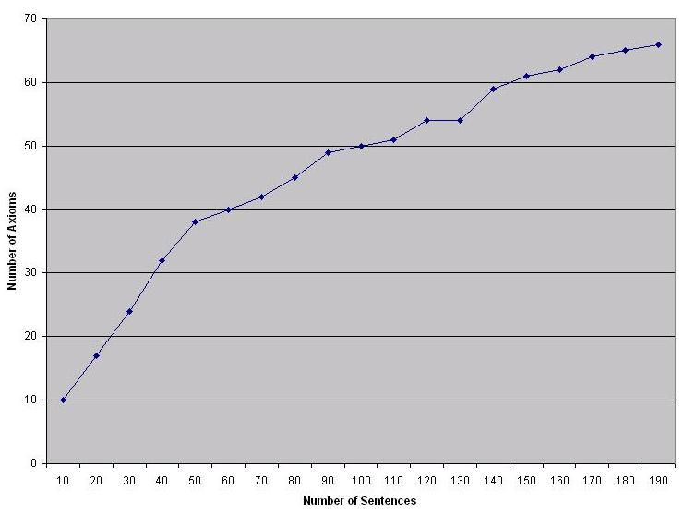
Completeness
Indicators of Completeness
Precision and recall with no bad parses (Precision: 100%, recall: 47.05%)
Graph of Axioms generated every 10 sentences
Manually created axioms incrementally 10 sentences at a time for 190 sentences
38 axioms were created in the first 50 sentences
7 axioms created in the last 50 sentences
Semi-Automatic Axiom Creation
Very few axioms were new over the manual effort

Slide 32
Multimodal knowledge interpretation
Identify the entities and events that occur in both the audio and video streams, across the modalities

Slide 33
Video Logical Forms
(every half second)

Slide 34
Logical Form of Text
Even those who want to stay are struggling.
Plural(x11,s11) ^ want’(e11,x11,e12) ^ stay’(e12,x11) ^ struggle’(e13,x11,e14)
Rosey Gallegos and her husband have enjoyed living here for over a decade.
Rosey(r1) & Gallegos(r1) ^ husband(h1,r1) ^ andn(x21,r1,h1)
^ poss(r1,h1) ^ enjoy’(e21,x21,e22) ^ live’(e22,x21) ^ perfect(e21)
^ present(e22) ^ for(e22,t11) ^ duration(e22,t11) ^ over(t11,t12)
^ decade(t12) ^ at-location(e22,l11) ^ in(l11,w1) ^ Wyoming(w1)
But now, his oil industry job has been moved to Texas and they are moving
with it.
but(e21,e36) ^ now(e35,u31) ^ person(x31) ^ male(x31) ^ poss(x31,j)
^ job(j) ^ oil(o) ^ industry(i) ^ nn(o,i) ^ nn(i,j) ^ move’(e31,z1,j1,w1,t1)
^ Texas(t1) ^ and’(e35,e31,e36) ^ move1’(e36,s1,w1,t1) ^ plural(x31,s31)
^ with’(e37,e36,j1)

Slide 35
Discourse Structure
DISCOURSE:
Example
struggle
want
stay
residents
Violated
Expectation
enjoy
living
here
Rosey-G
husband
Cause
move
job
Texas
move
they
with
it

Slide 36
Discourse Structure
DISCOURSE:
Example
struggle
want
stay
residents
Violated
Expectation
enjoy
living
here
Rosey-G
husband
Cause
move
job
Texas
move
they
with
it

Slide 37
Integrating Discourse and Video
VIDEO:
MOVE
DISCOURSE:
Example
....
PACK
struggle
want
stay
residents
Violated
Expectation
MAN TRANSPORTS
CARTON FROM
HOUSE TO TRUCK
WOMAN IN
KITCHEN
CARRIES POT
FROM CABINET
TO TABLE
....
enjoy
living
here
Rosey-G
husband
Cause
move
job
Texas
move
they
with
it

Slide 38
Integrating Discourse and Video
VIDEO:
MOVE
DISCOURSE:
Example
....
PACK
struggle
want
stay
residents
Violated
Expectation
MAN TRANSPORTS
CARTON FROM
HOUSE TO TRUCK
WOMAN IN
KITCHEN
CARRIES POT
FROM CABINET
TO TABLE
....
enjoy
living
here
Rosey-G
husband
Cause
VERL: Video Event Recognition Language
move
job
Texas
move
they
with
it

Slide 39
Abducing Motion
welcome - cbnt1
welcome - cbnt1
welcome - cbnt1 - light
cbnt1 - light - cbnt2
cbnt1 - - stove - cbnt2 - wndo1
cbnt1 - - stove - cbnt2 - wndo1 - cbnt3 - dshwshr - fridge - table - wndo2
wndo1 - cbnt3 - dshwshr - fridge - table - wndo2
wndo1 - cbnt3 - dshwshr - fridge - table - wndo2
VERL definition of move(x,y,z):
Sequence(at(x,y),
at(x,z))
Motion of woman
2
3
4
5
6
7

Slide 40
Interpreting Events
Changing relations of woman l1 and flowerpot f1:
reach-for(l1, f1)
grasp(l1, f1)
hold(l1, f1) & above(f1, c1)
hold(l1, f1)
<obscured>
hold(l1, f1)
on(f1, t1) & near(l1, t1)
carry(l1,f1,c1,t1)
move(l1,c1,t1)
release(l1,f1)
VERL definition of carry(x,y,a,b):
Sequence(grasp(x,y),
AND(hold(x,y), move(x,a,b))
release(x,y))
VERL definition of release(x,y):
Sequence(hold(x,y),
NOT(hold(x,y)))

Slide 41
Text-Video Coreference
TEXT
VIDEO
“Rosey Gallegos and ...”
Rosey(r1)
Gallegos(r1)
woman(l1)
l1=r1
Rosey(r1)

Slide 42
Textual Coreference
struggling for what?
“Even those who want to stay are struggling.”
want’(e11,x11,e12) & stay’(e2,x11) & struggle’(e13,x11,e14)
goal(e12,x11)
e14=e12
work-for’(e13,x11,e14) & goal(e14,x11)
& difficult(e13)
struggle’(e13,x11,e14)

Slide 43
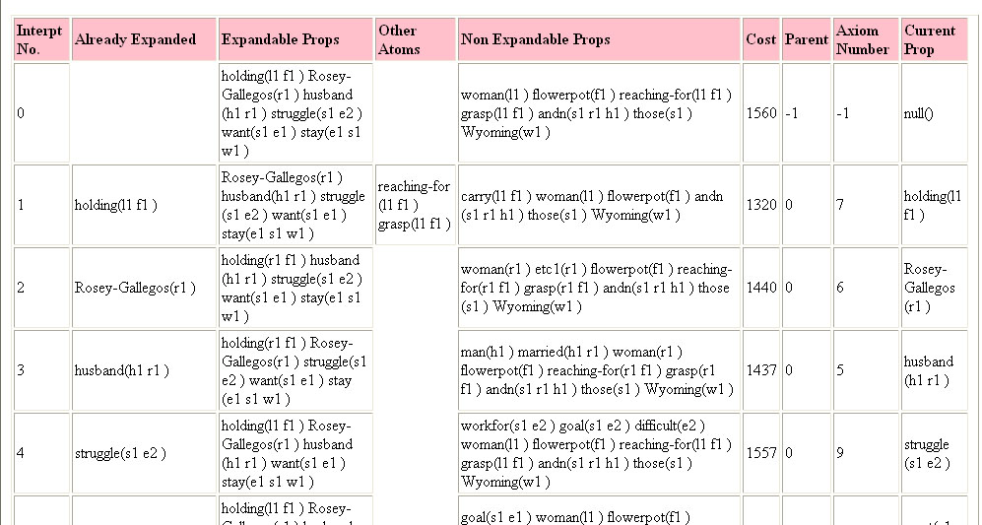
Inference Engine
Video and Text
Logical Form
Backchaining
woman = Rosey

Slide 44
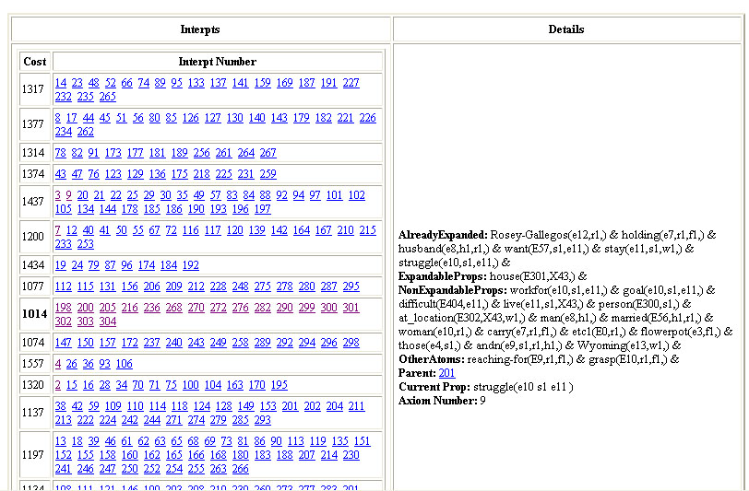
Lowest-cost
interpretations

Slide 45
One of the lowest-cost
interpretations

Slide 46
Coreference between Successive Scenes
cabinet(c)
dishwasher(d)
house(h)
stove(s)
table(t)
kitchen(k) & part(k,h)
house(h)

Slide 47
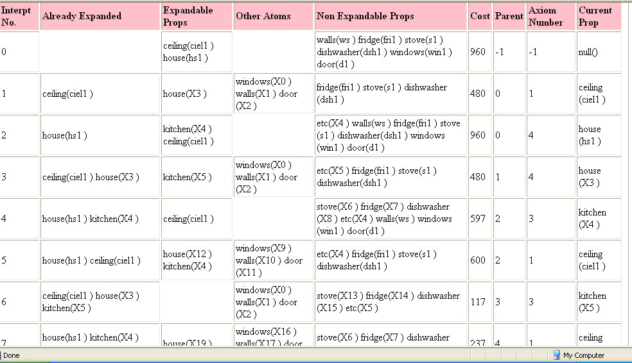
Kitchen hypothesized
Video Logical Form

Slide 48
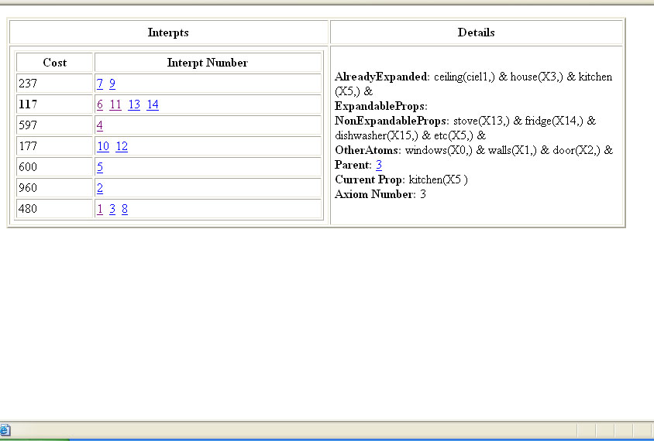
Lowest-cost Interpretation

Slide 49
Integrating Dynamically: 1
VIDEO:
DISCOURSE:
WOMAN
POT
CABINET
Even those

Slide 50
Integrating Dynamically: 2
VIDEO:
DISCOURSE:
want
stay
residents
WOMAN
POT
CABINET
who want to stay

Slide 51
Integrating Dynamically: 3
VIDEO:
DISCOURSE:
struggle
want
stay
residents
WOMAN
POT
CABINET
are struggling.

Slide 52
Integrating Dynamically: 4
VIDEO:
DISCOURSE:
Example
struggle
want
stay
residents
WOMAN
CARRIES POT
FROM CABINET
Rosey-G
Rosey Gallegos
and

Slide 53
Integrating Dynamically: 5
VIDEO:
DISCOURSE:
Example
struggle
want
stay
residents
WOMAN IN
KITCHEN
CARRIES POT
FROM CABINET
Rosey-G
husband
her husband

Slide 54
Integrating Dynamically: 6
VIDEO:
DISCOURSE:
Example
struggle
want
stay
residents
WOMAN IN
KITCHEN
CARRIES POT
FROM CABINET
enjoy
Rosey-G
husband
have enjoyed

Slide 55
Integrating Dynamically: 7
VIDEO:
DISCOURSE:
Example
struggle
want
stay
residents
WOMAN IN
KITCHEN
CARRIES POT
FROM CABINET
TO TABLE
enjoy
living
here
Rosey-G
husband
living here for
over

Slide 56
Integrating Dynamically: 8
VIDEO:
DISCOURSE:
Example
struggle
want
stay
residents
Violated
Expectation
WOMAN IN
KITCHEN
CARRIES POT
FROM CABINET
TO TABLE
enjoy
living
here
Rosey-G
husband
a decade.
But now

Slide 57
Integrating Dynamically: 9
VIDEO:
DISCOURSE:
Example
struggle
want
stay
residents
Violated
Expectation
MAN
CARTON
HOUSE
WOMAN IN
KITCHEN
CARRIES POT
FROM CABINET
TO TABLE
enjoy
living
here
Rosey-G
husband
his oil industry

Slide 58
Integrating Dynamically: 10
VIDEO:
DISCOURSE:
Example
struggle
want
stay
residents
Violated
Expectation
MAN TRANSPORTS
CARTON FROM
HOUSE
WOMAN IN
KITCHEN
CARRIES POT
FROM CABINET
TO TABLE
enjoy
living
here
Rosey-G
husband
job has been
job

Slide 59
Integrating Dynamically: 11
VIDEO:
DISCOURSE:
Example
struggle
want
stay
residents
Violated
Expectation
MAN TRANSPORTS
CARTON FROM
HOUSE
WOMAN IN
KITCHEN
CARRIES POT
FROM CABINET
TO TABLE
enjoy
living
here
Rosey-G
husband
move
job
Texas
moved to Texas

Slide 60
Integrating Dynamically: 12
VIDEO:
DISCOURSE:
Example
struggle
want
stay
residents
Violated
Expectation
MAN TRANSPORTS
CARTON FROM
HOUSE
WOMAN IN
KITCHEN
CARRIES POT
FROM CABINET
TO TABLE
enjoy
living
here
Rosey-G
husband
Cause
move
job
Texas
they
and they

Slide 61
Integrating Dynamically: 13
VIDEO:
MOVE
DISCOURSE:
Example
....
PACK
struggle
want
stay
residents
Violated
Expectation
MAN TRANSPORTS
CARTON FROM
HOUSE TO TRUCK
WOMAN IN
KITCHEN
CARRIES POT
FROM CABINET
TO TABLE
....
enjoy
living
here
Rosey-G
husband
Cause
move
they
with
it
are moving
with it.
move
job
Texas

Slide 62
Summary
Uniform representation of content of video and text
Inference engine for interpreting and linking:
e.g., coreference within and across modalities
Within a larger program for building knowledge bases
of commonsense knowledge for NLU:
Ontology of time
Ontology for video events
Deep Lexical Semantics for Core WordNet
Commonsense Psychology
But ….
Image processing and speech recognition not quite there
So far, this is only a toy

